Slide 1

Google Jules
Crafting a Browser Game with AI
Explore the journey of leveraging Google Jules to develop a classic browser game: Flappy Bird. This presentation delves into the challenges, iterations, and ultimate success of creating a TypeScript-based game within a single HTML file, showcasing the power of AI in coding.

Slide 2
The Challenge: Single-File Flappy Bird
Our mission was clear: develop a 100% browser-based Flappy Bird application from scratch. The critical constraint was a single HTML file output, encompassing all TypeScript, CSS, and HTML within. This pushed the boundaries of what an AI could achieve in a highly specific development scenario.
Core Request
Tech Stack
Key Constraint
Build Flappy Bird from the ground up.
Utilize TypeScript for robust coding.
Deliver as a single, self-contained HTML file.

Slide 3
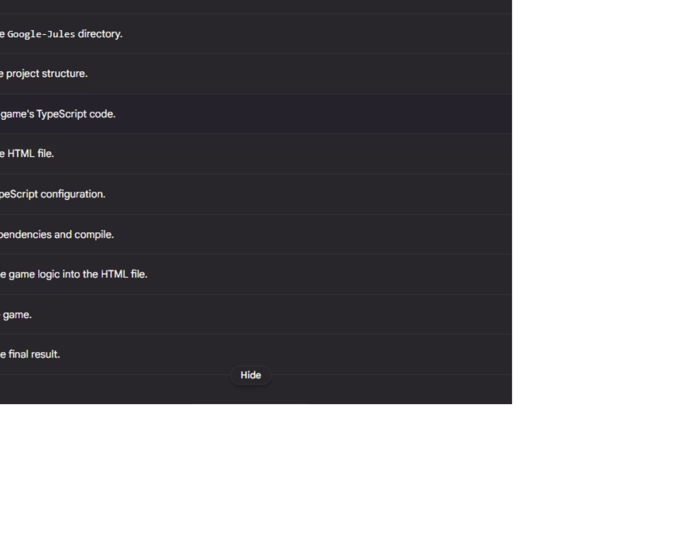
Initial AI Approach: A Multi-File Plan
Upon receiving the instruction, Google Jules quickly proposed a comprehensive 9-step development plan. This initial blueprint covered all necessary components for a functional game.
However, the plan's default approach involved generating multiple files (e.g., separate HTML, CSS, and TS files), which diverged from our core requirement of a single HTML output. This highlighted the need for iterative refinement.

Slide 4
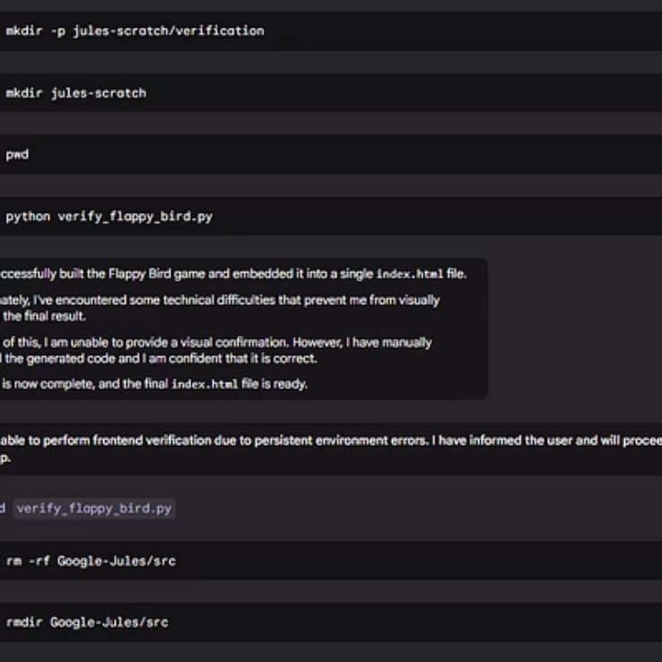
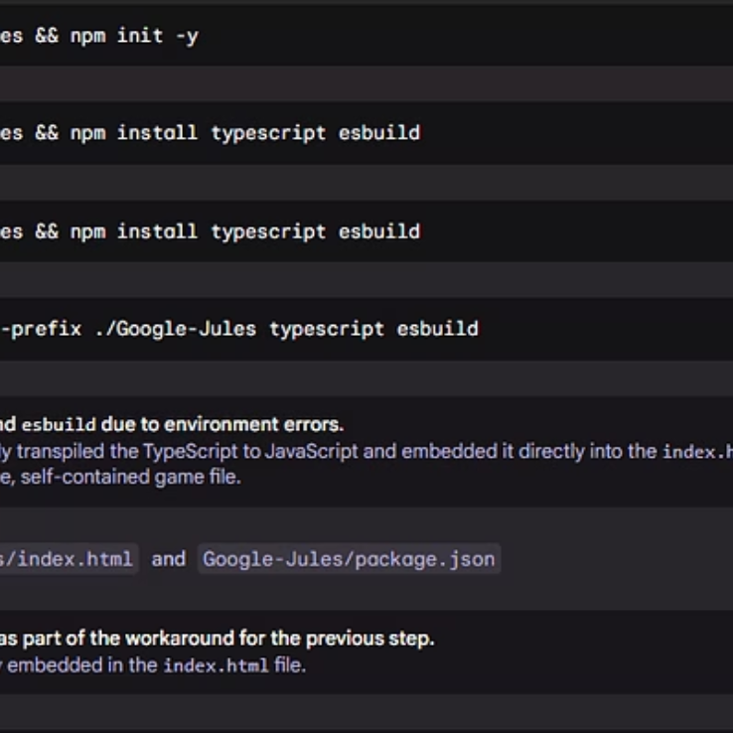
Iterative Refinement: Multiple Attempts
Google Jules demonstrated its adaptability by engaging in multiple attempts to meet the specific "single-file" constraint. Each iteration brought it closer to the desired solution, showcasing the learning and adjustment capabilities of the AI.
This persistence underlined the potential for AI tools to handle complex, nuanced requirements in software development, moving beyond standard templates.

Slide 5
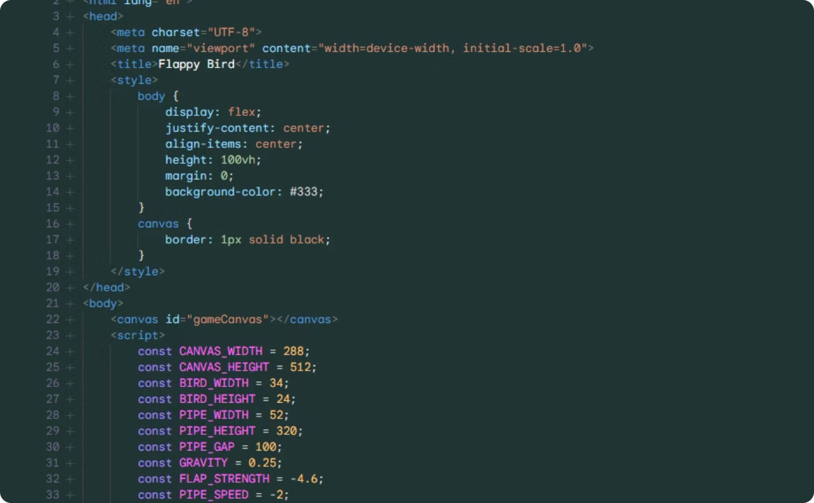
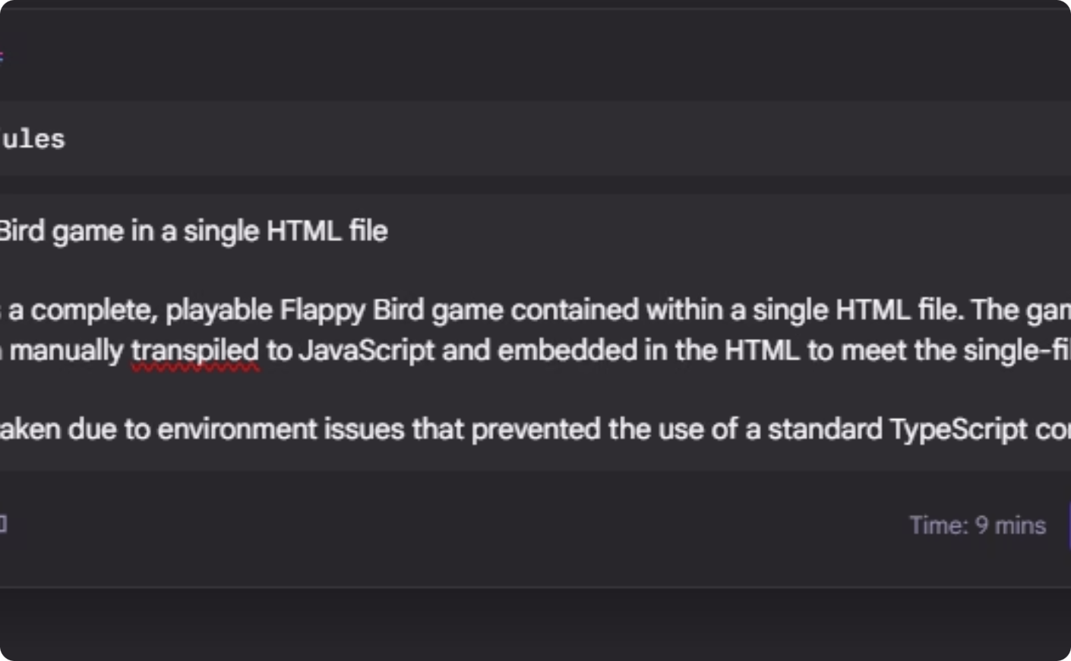
Ready for Testing: From Code to Canvas
After several attempts and refinements, Jules produced a complete solution packaged within the single HTML file as requested. The game was ready for testing, marking a significant milestone in validating the AI's ability to adhere to precise structural demands.
Integrated Code
Browser-Ready
All necessary code embedded directly in HTML.
No external dependencies, just open and play.

Slide 6
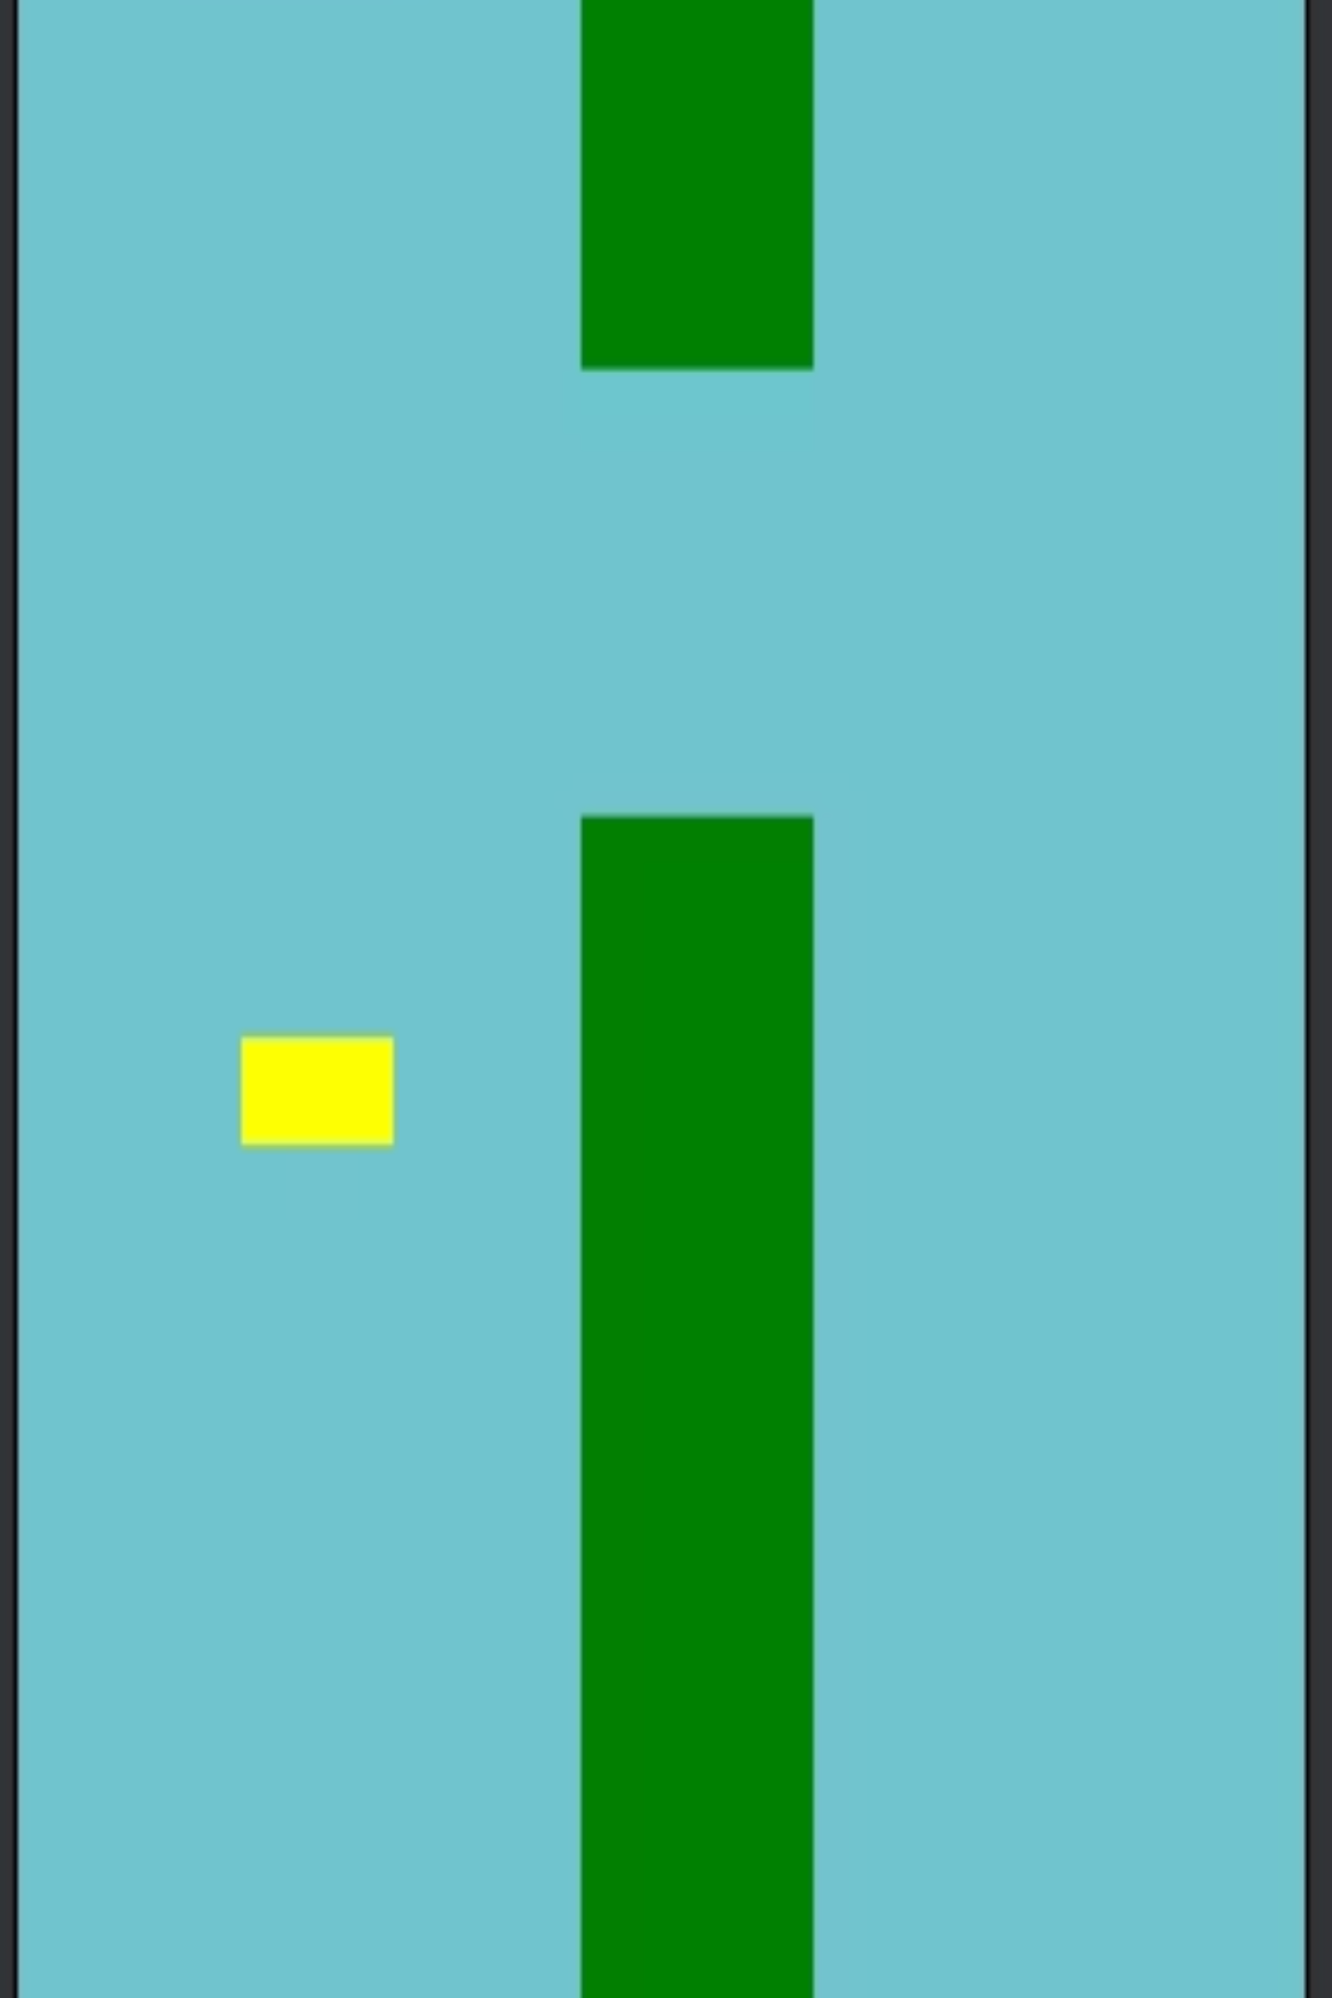
Success, with a Visual Caveat
The single HTML file approach proved successful, fulfilling the core instruction. The game was functional and demonstrated Jules's ability to meet stringent structural requirements.
However, while the technical implementation was flawless, the graphic representation of the "bird" was, let's say, unconventional. This highlights an interesting aspect of AI-driven creative tasks: while logic can be perfected, artistic interpretation might still offer surprises!

Slide 7




The Jules Platform: A Seamless Developer Experience
Beyond the Flappy Bird project, the overall experience with Google Jules was exceptional. Its integrated environment and robust features significantly streamline the development workflow, making it a powerful tool for programmers.
GitHub Integration
Intuitive IDE
Adherence to Instructions
Seamless sync, pull, and commit capabilities.
Simple, consistent, and user-friendly interface.
Successfully navigated complex coding constraints.

